Slide 1





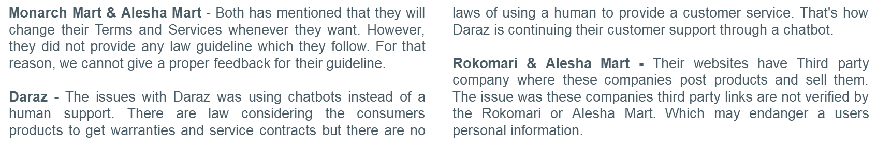

Case Study on
E-Commerce in Bangladesh
A discussion about ToS, EULA, Privacy Policy fulfilling the legal requirements and the existing practices of 6 e-commerce site in Bangladesh.
It includes criticism, comparison policies among these 6 sites.
²
Lackings on Terms and Services
Nowadays, the majority of websites contain links from third parties that promote the products, businesses, etc. Third-party links might include malicious malware or phishing scams that can steal users' personal information or other things. There are no terms for monitoring dangerous viruses or phishing scams in the organizations. The section 52 of Consumers' Right Protection Act 2009 declared that anything that endangers a service receiver's life or security is a serious offense.
According to the needs of the companies, the Terms and Services may change from time to time. If the terms and Services change after a purchase, customers may face difficulties availing of any services related to the product. The Court must issue an order to confirm any changes to Terms and Services, according to Section 13 of the Company Act of 1994. On every e-commerce website, however, it is stated that terms and services are subject to change without prior notice.
Daraz is providing customer support through a chatbot which may not lead users to find the appropriate answer. There should be a human interaction that is provided by the other e-commerce websites.
3rd Party Link Verification
Change of T&S
Customer Support
Concerned Privacy Policy
What Went Wrong by EVALY?
Daraz stated that when users use their voice search function, they gather biometric data such as speech files and face recognition, as well as the user's facial attributes when they visit the Site. However, they make no specific mention of the use of biometric data. Why does an e-commerce site require face recognition?
Alisha Mart collects driving license if it is available from the user. As an e-commerce, why they need users driving license?
Monarch Mart is most transparent among the e-commerce about the third party uses of data, but the they shares very much all the data to the third parties.
Rokomari’s privacy policy is easier to read, but Rokomari and Chaldal noted on their website, that all of their terms and conditions were based on the outdated ICT ACT of 2006, which is no longer in effect. Even though their terms and conditions do not infringe on the most recent law, it is essential to highlight The Digital Security Act 2018 in its terms and conditions.
Consumer Rights Protection Act 2009
Consumer Rights Protection Act 2009
Did not communicate properly with customers
Failed to deliver product on time after taking advance payment
Penal Code 1860
Consumer Rights Protection Act 2009
Not only failed to deliver the goods to the clients, but also failed to refund the money for their orders.
Digital Security Act 2018
Penal Code 1860
Findings and Discussions
Evaly – They failed to provide customers product, money and did not establish proper communication. For that reason, they were sued and, were arrested and were sent to jail for breaking laws towards customers. This incident made the government more focused for creating framework for e-commerce.
Sources
https://www.daraz.com.bd/
https://chaldal.com/
https://monarchmart.com/
https://www.rokomari.com/
https://aleshamart.com/
Law
https://dncrp.portal.gov.bd/site/page/81410ae5-17d8-456c-8cff-4bbd8742d809/The-Consumers%E2%80%99-Right-Protection-Act,-2009-
https://www.iiiglobal.org/sites/default/files/companiesact_0.pdf
http://bdlaws.minlaw.gov.bd/act-11.html
https://www.cirt.gov.bd/wp-content/uploads/2020/02/Digital-Security-Act-2020.pdf
Presenters:
Md. Shahadat Anik Sheikh (2019-1-60-068)
Rashik Buksh Rafsan (2018-3-60-088)
Hasib Ar Rafiul Fahim (2019-1-60-036)
Department of Computer Science and Engineering

